Slide 1
Food Franchisee Management System
Jeet Jivrajani (201501039)
Priya Mehta (201501085)
Vishwa Saparia (201501118)

Slide 2
Acknowledgement
We would like to thank Professor Daxesh Shah for encouraging us to take up such a database management project which helped us understand various concepts of DBMS. We would also like to thank Mrs. Purnima Shah, Shreedhar Dalal, Madhav Chauhan, Miloni Mehta and Shachi Turakhia for their valuable time and guidance. We would also like to thank the institute for offering us such a course.

Slide 3
Introduction
Food franchisee management system is a database system which helps the different franchises of a restaurant to manage different records regarding different aspects.
Also these could be used to compare the performance of different franchisee and check their working and efficiencies.
It can be divided into three main categories:
Franchisee detail maintenance
Customer records and details
Employee records and details

Slide 4
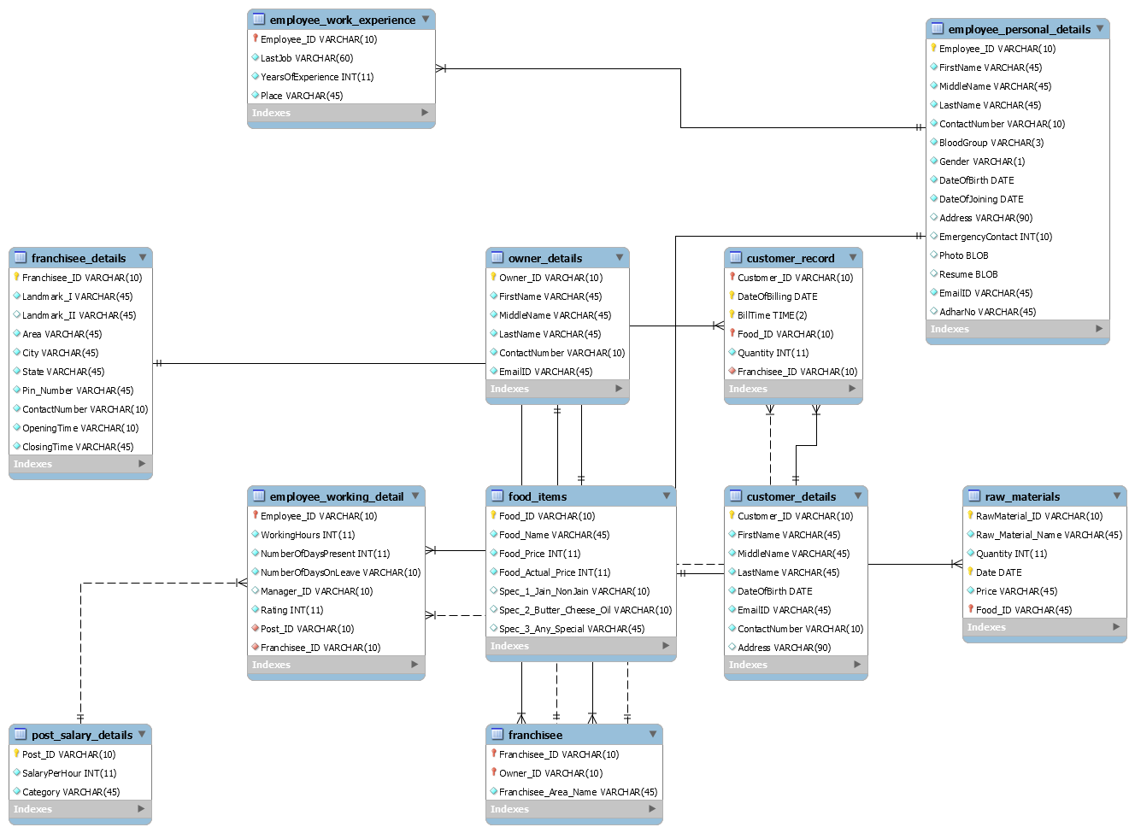
Entity Relationship Diagram

Slide 5
Relationships
Many to One | One to Many
employee_work_experience -> employee_personal_details | owner_details -> franchisee
customer_record -> food_items | franchisee_details -> franchisee
customer_record -> franchisee [Referential Integrity] | post_salary_details -> employee_working_details [Referential Integrity]
customer_record -> customer_details
raw_materials -> food_items
employee_working_details -> employee_personal_details
employee_working_details -> franchisee
Referential Integrity : Primary key changes must be applied to the
corresponding foreign key

Slide 6
Tables
post_salary_details : Consists of the various posts of the franchisee and the salaries offered to each.
employee_working_details : Consists of details like the presence of employee, working hours, rating, manager, the post and the franchisee which the employee works in.
employee_work_experience : Consists of the details of the past jobs and it’s tenure.
employee_personal_details : Consists of various personal details of employee.

Slide 7
franchisee_details : Consists of various physical details of the franchisee and it’s opening and closing time.
franchisee : Consists of the owners which own the franchisee and it’s area.
owner_details : Consists of various personal details of the owner.
food_items : Consists of various details of food items and it’s prices.
raw_materails : Consists of details and prices of raw materials used by the franchisee.

Slide 8
customer_record : Billing details of each customer.
customer_details : Consists of various personal details of the customer.

Slide 9
Normalization
The tables are already normalized in the first form since there are no multi valued attributes. Hence each field can accept only one value.
The franchisee table and the raw_materials table were not 2NF. In raw_materials, the attribute raw_material_name just depended on raw_material_ID and not on the other primary keys. Hence, raw_material_name along with raw_material_ID was shifted to another table.
In the franchisee table, the franchisee area depended just on the franchisee_ID and not on the owner_ID. Hence franchisee_ID along with franchisee_name was shifted to a different table.
After making the tables 2NF, we checked for 3NF and all the tables were found to be 3NF.

Slide 10
List of Queries
Total amount of money which goes into the salary of employees.
Total profit for each franchisee.
Number of employees working on a particular post in a particular franchisee.
Provision of offers and discounts on a registered customer’s birthday.
The most ordered food item at a particular time slot.
Ordering raw materials according to the most frequently ordered food item
Highest grossing franchisee.
Provision of offers and discounts on a registered customer’s birthday.
Listing the irregular employees and fetching his/her details in order to contact them.

Slide 11
The amount of money which goes in the purchase of raw materials
The total profit gained by a particular food item can be calculated and hence we can know the highest grossing food item.
Salary of an employee calculated according to the working hours and the post.
The performance of employee is measured by the average of all the ratings given by the manager/customers.
Most used raw material.
Cost of raw materials incurred for a food item.
Details of franchisees owned by one owner.
Delete the data of raw materials older than a day.
Total order of a particular food item in a particular food franchisee.
Number of Franchisee owned by an owner.
Total number of particular food item ordered per franchisee.

Slide 12
Constraints
Sufficient data is not entered and hence we don’t know if the database will work efficiently when released in the market.
Generalization of different franchisees are different and creating a database covering all the specifications is hard.
Employee working record was limited.

Slide 13
Assumptions
Food chains can have any number of franchisees.
Employees have various different posts and each post has a different salary.
Only the recent data of raw materials will be stored. Other old data will be deleted.
Prices for food items for all franchisees are the same.
There will be a set of parameters on which the employee is rated.

Slide 14
Future Scope
Better management of customer records and his ordering history.
Making specific changes for different food chains.
Different level of data can be accessed by different level of employees according to their post.
Login credentials for employees.
Using database records to recommend different food items to individual customers.

